Slide 1

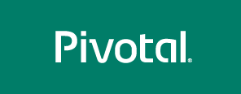
Introduction to Pivotal Cloud Foundry

Slide 2
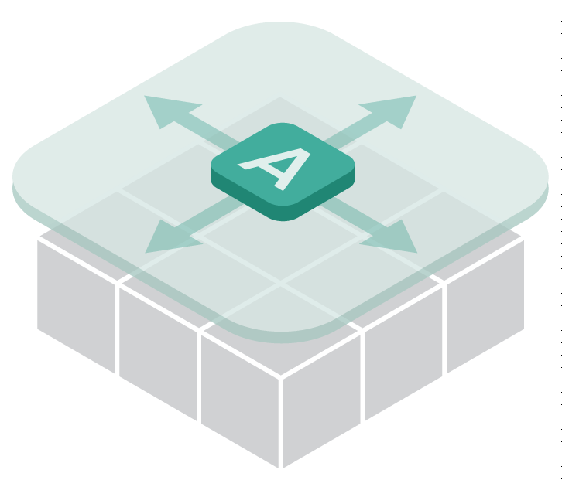
Changing Model for Application Delivery
Abstraction Layer
Architecture
Development
Deployment
“Day 2” Ops
Monolithic App
Linear / Sequential
App Server on Machine
Sparingly at designated times
Many tools, ad hoc automation
Microservices / Composite app
Short cycles, test driven, iterative
App on “disposable” infrastructure
Ready for prod at any time
Manage services, not servers
Notes:
How are they transforming?
Transformation happens across multiple dimensions.
On the architecture dimension we see a movement from building monolithic apps to microservices –
Microservices aims to reduce inherent application complexity and tight coupling by building small scalable apps that can be deployed and released independently.
On the development side we are seeing movement from waterfall or water scrum fall to short iterative development and releasing frequently.
This gives combined with test driven development gives the ability to have tight feedback loops
We are seeing a movement to disposable infrastructure – cattle vs pets mentality. Systems are being build as highly scalable and resilient software.
Instead of deploying code once or twice a year, we are seeing a movement towards building toolchains and pipelines that deliver code continuously, whenever the business needs to (Amazon deploys code every minute) – Applications are deployed using blue-green deployment patterns, infrastructure is upgraded with zero downtime rolling upgrades.
Lastly, we are seeing a movement towards DevOps and a focus on services and not servers.

Slide 3
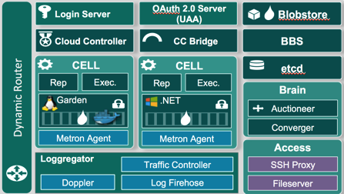
PCF Architecture

Slide 4
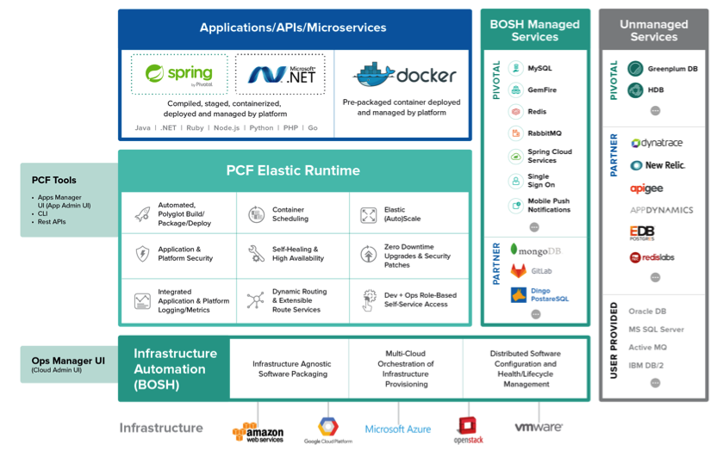
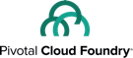

Slide 5
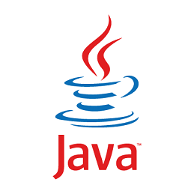
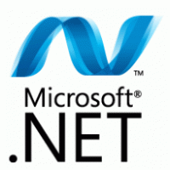
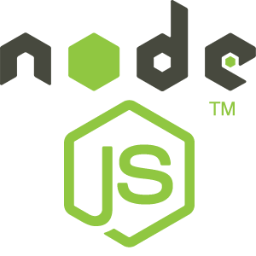
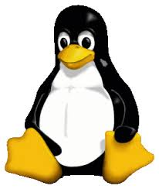
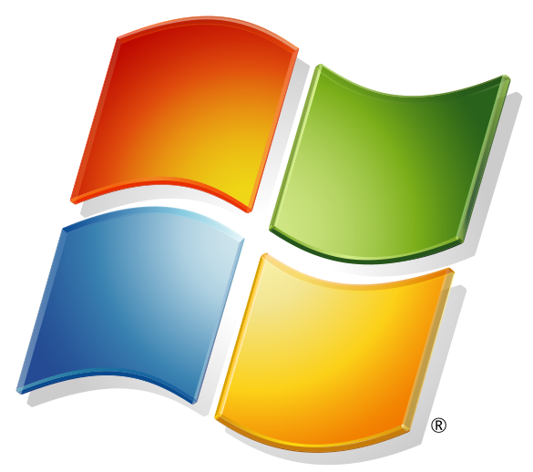
DEVELOPMENT
OPERATIONS
Multiple
Languages
App Deployment
& Management
CI/CD Tools,
ID, Security
Microservices
Support
Health, Metrics
Patching
Availability
Services
Marketplace
Native
User Provided
Partner
Visibility &
Administration
Apps & Platform
Dashboards
Exploratory Questions:
Ask the VP if they agree with value line and their view of their world is.
Ask them what parts of their job is most visible to the outside & external teams
What aspects of their job are important to them?
VALUE LINE
Operating
System
Container Orchestration
Cloud API
Notes:
Biggest reason why teams can deliver quickly is the friction in moving code.
The PCF platform provides integration and automation on both sides of this line we’re calling the value line to help IT ops focus their resources where they can maximize the strategic impact of their org.
From Our POV: Everything on top of value line, that is YOUR apps and how quickly YOU can get them out there is what brings maximum value to your business.
You are Improving Developer Velocity and business satisfaction, {point top left}
You benefit from better Uptime, improved MTTR, improved admin-server ratio and reduce the impact of breakages. These are the things that are most visible to the business and external teams {point top right}
{point below line}
And down here, below the line is where we have spent a lot of time on automation so you don’t have to. Everything below is very important, but ultimately non-differentiating to you and your business. No CEO ever said “great job managing those Operating systems”.
Unfortunately, Most of the Ops teams live down here, stuck, trying to build that automation on a per app and per BU basis (below the line). But the real value is actually up here and here and ops teams are making herculean efforts to make a mark here (top of line). Do you agree ? (ask the VP if they agree and see if how they view the world)

Slide 6
Demo

Slide 7
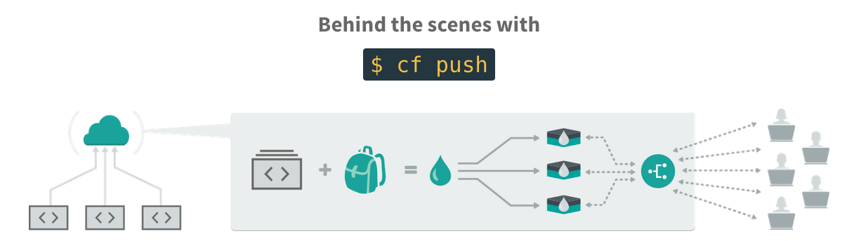
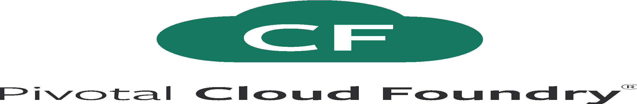
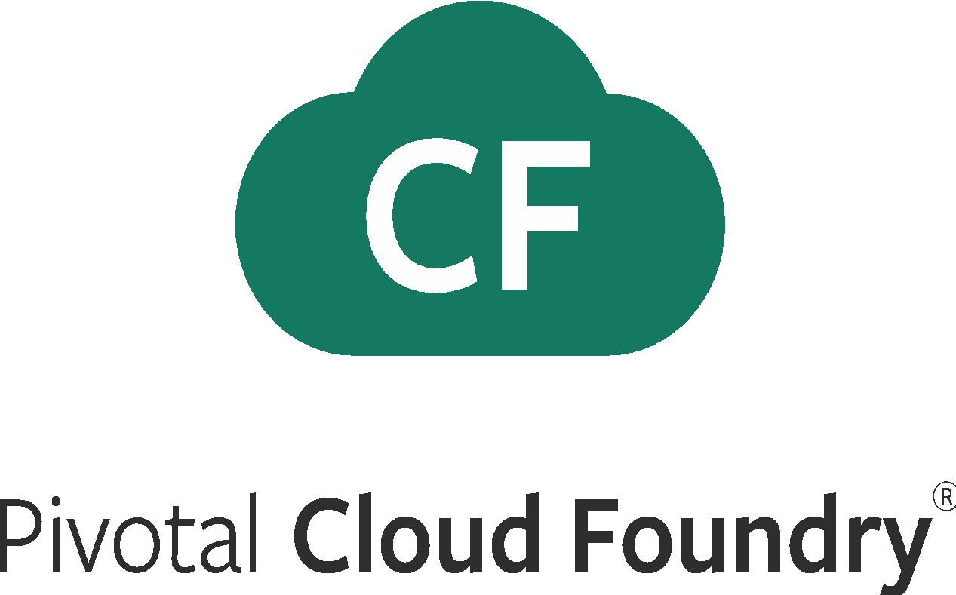
Automate Deployments
Upload
‘cf push’ uploads the application bits and metadata to the Cloud Controller
Stage
Behind the scenes the code goes through a set of staging scripts called BuildPacks which create a container blueprint called ‘Droplet’
Distribute
‘Diego’ which is an auction based workload scheduler spins up containers and with the ’Droplet’ image, and alerts the ‘Cloud Controller’ that the app is ready to receive traffic
Route
Your app receives an entry in the routing tier which provides a dynamic loadbalancer
Notes:
We keep the cf push workflow simple and don’t get into the details of DIEGO. We only keep the BRAIN and Cell.
Cloud Foundry PaaS – Pushing an Application with Diego
App deployment: what has changed?
1- Domain specific (notion of apps) -> Abstractions (notions of LRPs and Tasks). App staging is a Task. App start is launching a LRP.
2- Platform specific (linux) -> Supporting multi platform (Windows & Linux) enabling running also .NET apps, thanks to our new Container implementation: Garden
What’s more, there is a 3rd workflow supported: Docker on Linux
3- New Auction-based workload scheduler: Cloud Controller no longer in charge of deciding where AIs are spun up. Auctioneer manages the process running an auction, making it more optimized.
With Diego in place, more loosely-coupled components take part in the process, stripping down the Cloud Controller from too many previous responsibilities, making it easier to maintain and evolve the entire architecture.
The Cloud Controller handles the routing of client requests internally through the Cloud Controller Bridge. It also manages the Blobstore to store packages and droplets and the DB to store App Metadata and Service credentials. Blobstore could be internal or external, depending on the setup.
A service gateway provides an interface for services (native or external).
More in the next slide about the Cloud Controller Bridge (CC-Bridge), the Bulletin Board System (BBS) and the Auctioneer in the next slide
Apps run in a CELL, part of the new Cloud Foundry Runtime, called Diego
Routers manage application traffic.
Diego handles all health management for apps (now LRPs), through a series of single-purpose components: Nsync (part of the CC-Bridge), BBS (part of Diego DB) and the Converger (part of the Diego Brain)
Apps are accessed directly through the router while web and CLI clients (e.g., vmc, STS) access Cloud Controller via RESTful services.

Slide 8
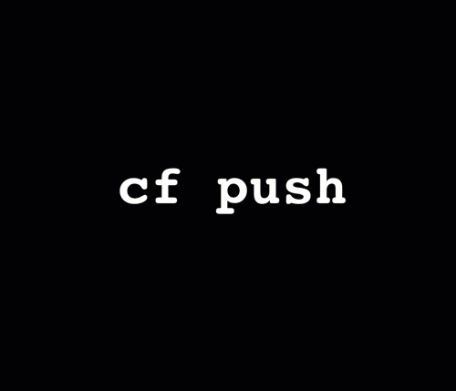
Simple but Powerful workflow

Slide 9
DEVELOPMENT
OPERATIONS
Multiple
Languages
App Deployment
& Management
CI/CD Tools,
ID, Security
Microservices
Support
Health, Metrics,
Patching
Availability
Services
Marketplace
Native
User Provided
Partner
Visibility &
Administration
Apps & Platform
Dashboards
Operating
System
Container Orchestration
Cloud API
Notes:
Now Lets take a closer look at the platform starting with how Ops can helps support Developer Velocity

Slide 10
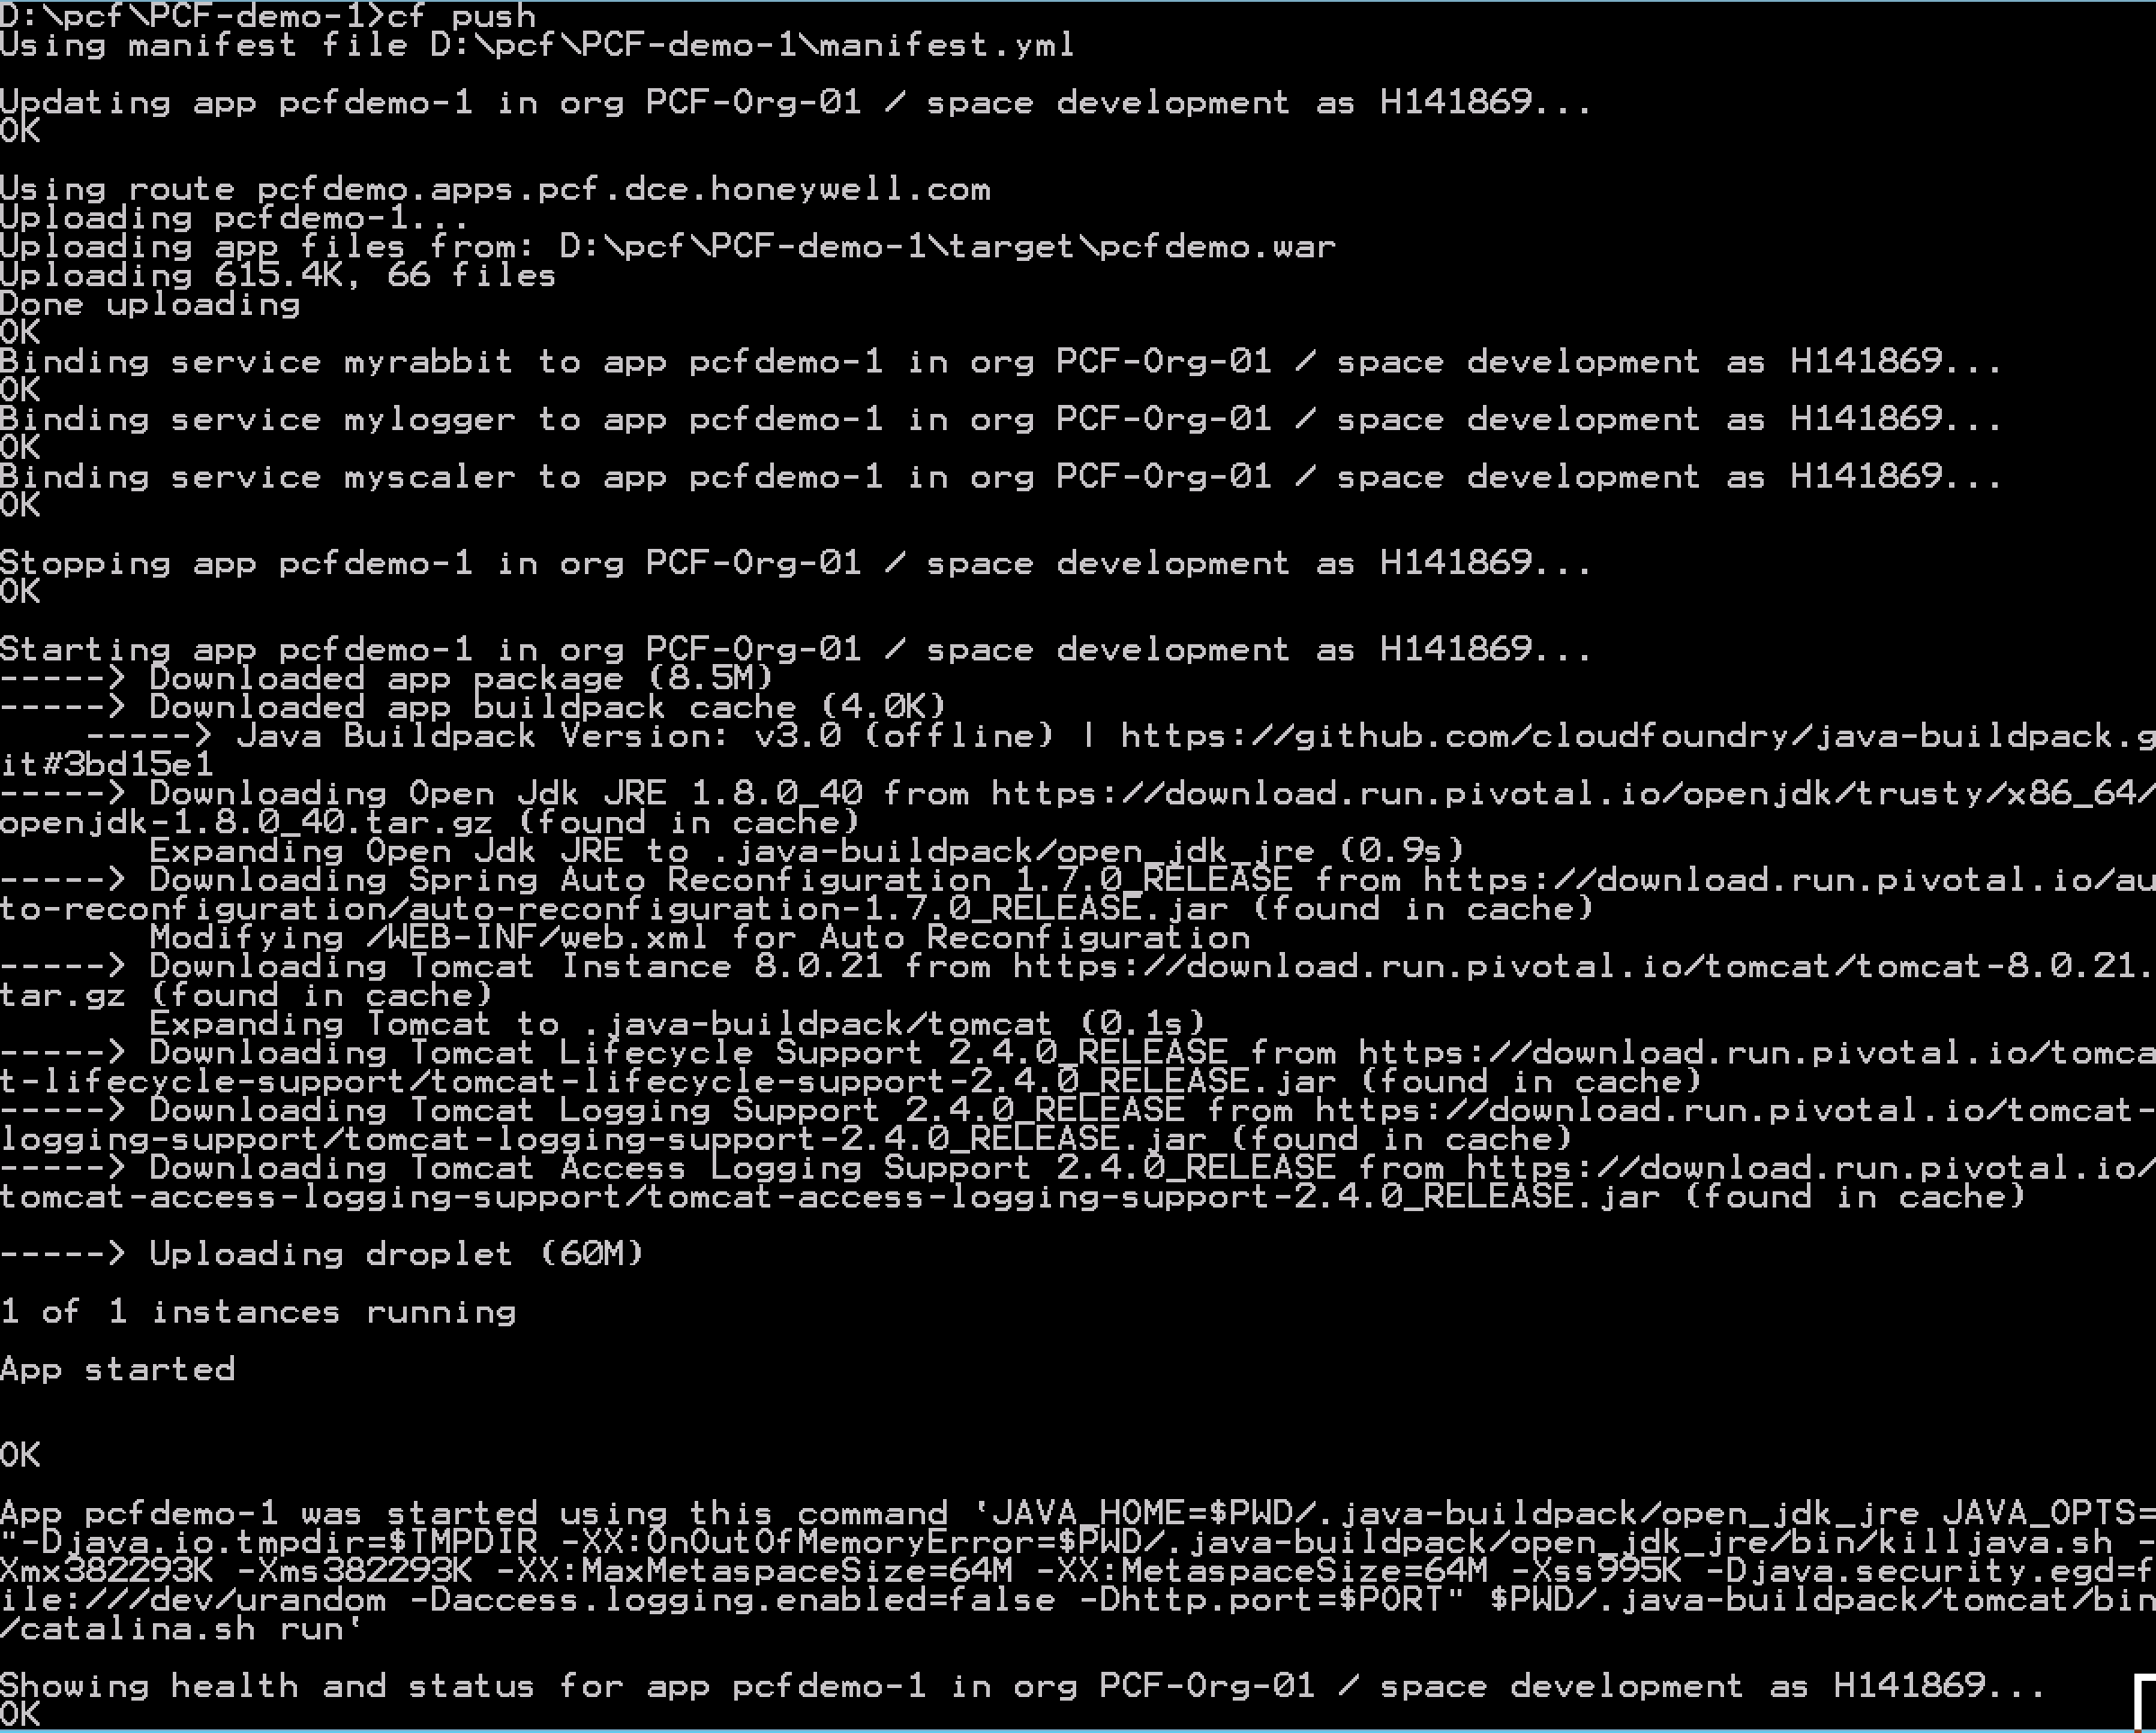
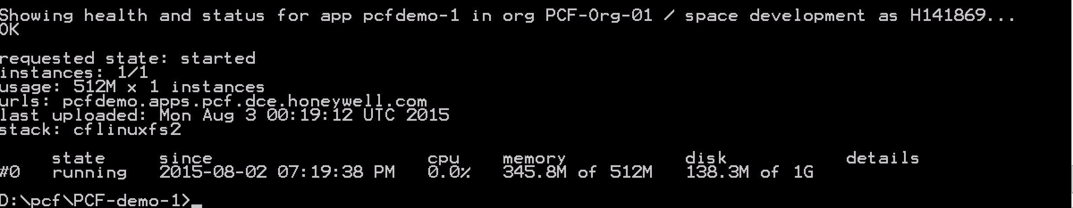
Eliminating Service Tickets
Firewall & Routes
Service Bindings
App Lifecycle
Runtime Installation & Config
Middleware Installation & Config
Application Installation & Config
App Lifecycle
Logging, Health, Telemetry

Slide 11
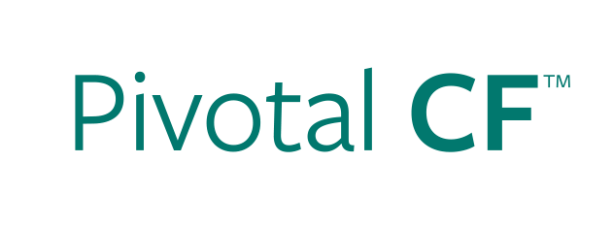

Deploying an Application
Provision VM
Install Application Runtime
Deploy Application
Configure Load Balancer
cf push
Configure SSL Termination
Configure Service Connectivity
Configure Firewall
Notes:
Highlight that not only are the steps longer in IaaS, but often there are multiple groups involved (ie, Dev, Operations, etc).
Management of configuration information is often manual in IaaS (though not always).
Explain that for non-virtualized customers, the steps are even greater.

Slide 12
Scaling an Application
Provision New VM
Install Application Runtime
Deploy Application
cf scale
Configure Load Balancer / Update Route
Configure Service Connectivity
Configure Firewall
Notes:
Highlight that not only are the steps longer in IaaS, but often there are multiple groups involved (ie, Dev, Operations, etc).
Management of configuration information is often manual in IaaS (though not always).
Explain that for non-virtualized customers, the steps are even greater.

Slide 13
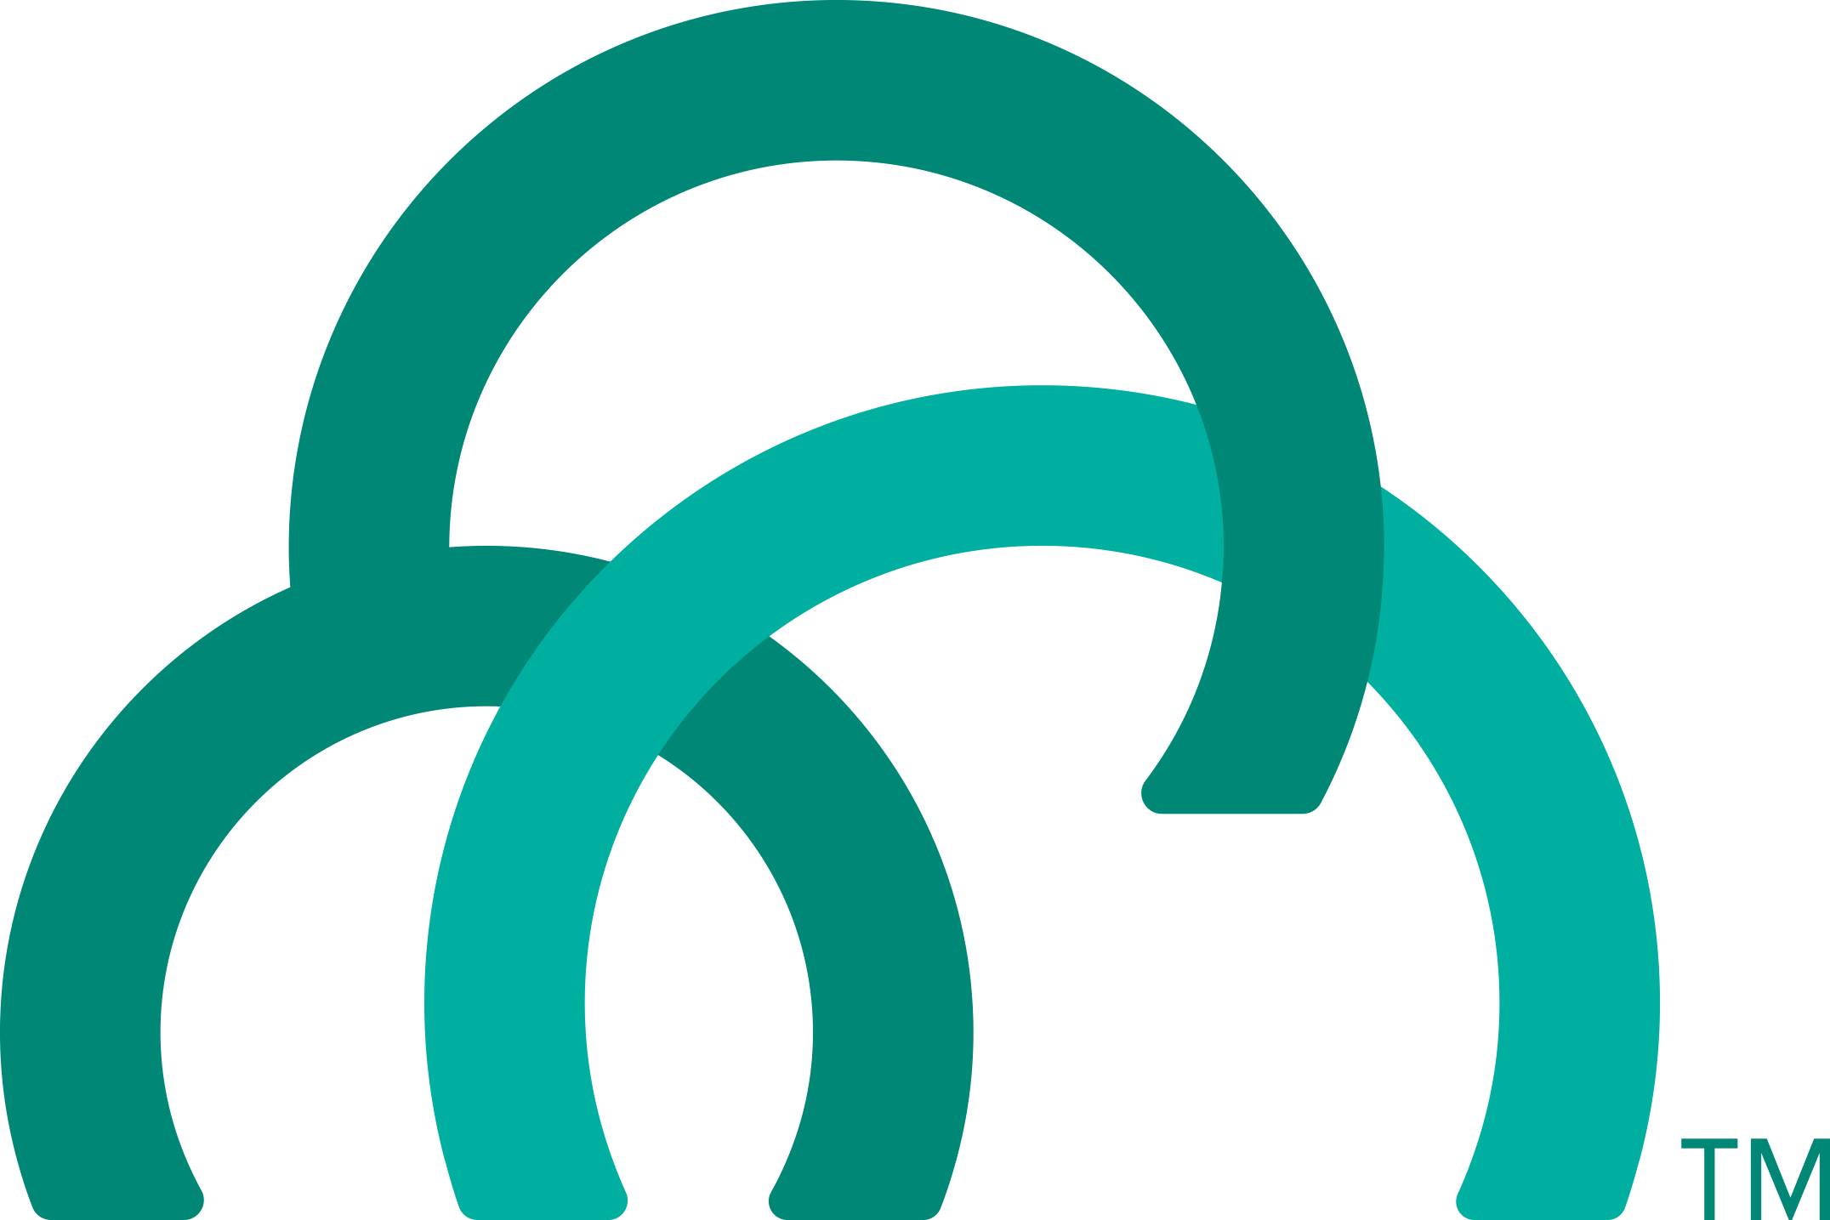

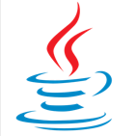
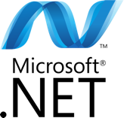


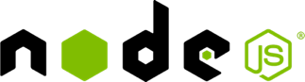
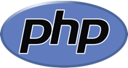

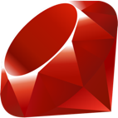

Developer Self Service Provisioning
Flexibility with control
>cf
Push App
http://
more…
Push your app and it just works…no “snowflakes”, no waiting.
Notes:
Because the Platform supports a number of languages and frameworks. Ops no longer prepares special app stacks and configurations
With just 1 platform, ops can easily provide devs the flexibility to use the languages of choice, and the same experience across all of them while greatly reducing IT complexity.
Environments can be made immediately available through self service with the right policies applied the second developers need it.
Devs simply push their app “cf push” either via command line or IDE. The platform detects what kind of app it is, provisions the resources and runs your app in a container - no waiting. Those resources like embedded webserver, the app configurations, the service connections that the app is bound to, are all bundled into what we call a “buildpack”. Ops teams can curate and customize the buildpacks to ensure developers are on the most secure and up to date versions.
<optional: if you know the devs want to use Docker>
PCF also runs Docker images. Docker is basically a container format and is “packaging and a subystem” concern. Docker by itself is not a platform and has limited value on its own. If Developers want to use Docker, they can now leverage the built in Pivotal Cloud Foundry platform capabilities that we will talk about shortly to run Docker images. This doesn’t mean that developers should pull together a random set of Docker images and magically get orchestration and management. We see developers building Docker images from their continuous integration processes. From our POV its just about offering an alternate mechanism for deploying code that’s independent of container formats so that developers continue to have flexibility.

Slide 14
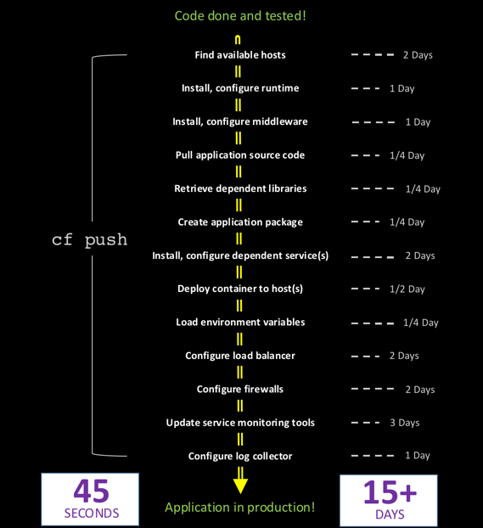
45 Second vs 15+ Day Deployments

Slide 15
2 Workflows: Runtime vs No-Runtime
Developer brings customized app
Developer brings customized app
Platform buildpacks provide standard runtime
Developer brings runtime container image
Platform provides fixed OS container image
Developer brings container OS image
Platform provides fixed host OS Kernel
Platform provides fixed host OS Kernel
App container
Notes:
Ease of use
Isolation and Security

Slide 16
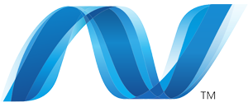
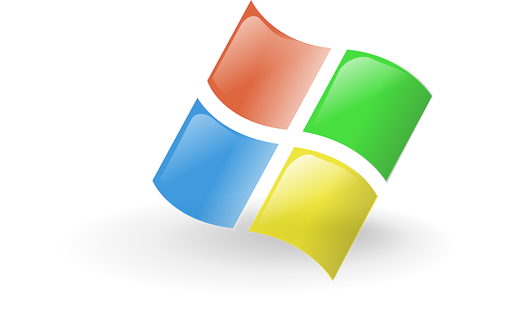
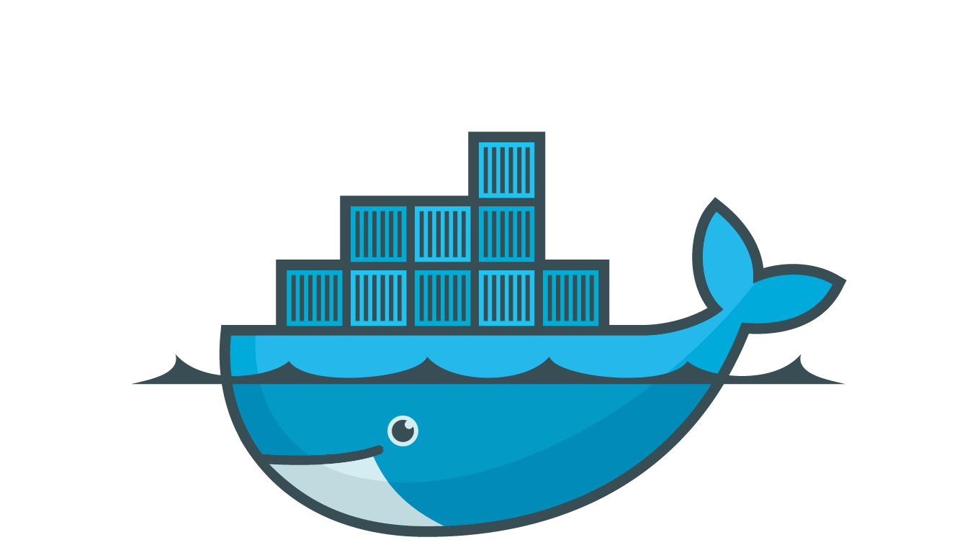
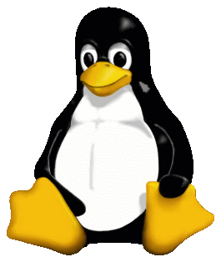

Container Scheduler Handles Workloads
Notes:
Pivotal Elastic Runtime is actually one of the most mature linux container scheduling environments in the world.

Slide 17
Container Scheduler Handles Workloads
Dynamic load balancing
Notes:
The platform distributes new work as it arrives and uses a pretty sophisticated process. A sophisticated algorithm balances application processes over the virtual machines and an Auction determines which processes should be allocated to which VMs while optimizing for application availability and resilience.

Slide 18
Container Scheduler Handles Workloads
Dynamic load balancing
Remediation and rebalance of workloads
Notes:
The platform monitors the applications, and if any of them crash, they get restarted and rebalanced across available capacity.
<CLICK>And as mentioned before the platform attempts to revive the VMs. None of this requires human intervention. (animation that shows this)

Slide 19
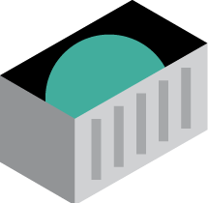

4 Levels of High Availability
1
2
3
4
App Instance Fail
Process Fail
VM Fail
Availability Zone Fail
Process
VM
VM
VM
VM
VM
VM
VM
VM
VM
VM
VM
VM
VM
Notes:
PCF was designed with the assumption that complex systems will develop inconsistencies over time. The platform is intelligent enough that it isn’t told what to do at every step, but its told the desired state of what it should be, and then it does the right things to make that be true. The constant checking, detection and remediation make sure that state always returns to consistency which can really have a positive impact on MTTR.
4 layers of Self healing built in to keep app available :
If an app instance fails, PCF restarts it in a new container
If a process fails PCF restarts, that is, failed cluster components are restarted which makes this a self healing system
If there is a problem detected in the VM, PCF kills that VM and spins up a new identical type of VM
And finally, PCF can be set up to distribute instances automatically across AZs. If an AZ is lost, App Instances keep running.

Slide 20
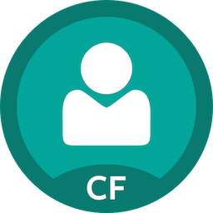
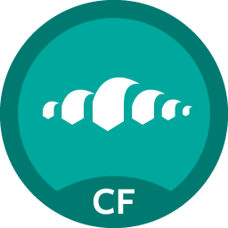
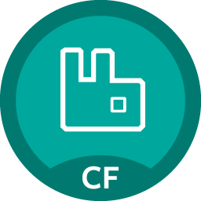

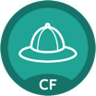
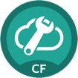
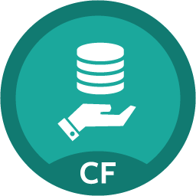
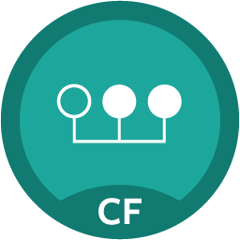
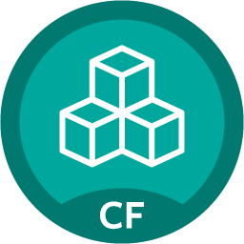
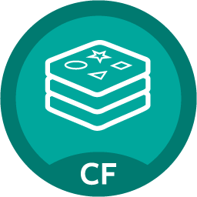
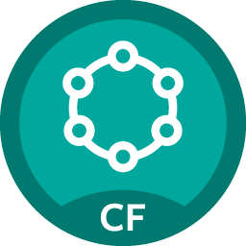
Services prepackaged for simple consumption
Services Marketplace
Easy accessibility through Marketplace
Instant Provisioning and full lifecycle managed
Bind to apps through easy to use interface
Common access control and audit trails across services
Single Sign-On
Jenkins Enterprise
RabbitMQ
Circuit Breaker
Service Directory
Config Server
MySQL
Session state caching
GemFire
Redis
DataStax Cassandra
AND MORE
Notes:
Services are pre-packaged for simple consumption on the platform
Devs get Easy access to supporting services for their apps
Services can be selected from many different offerings and consumed through our built in marketplace that can be managed and curated by Ops.
Single Sign On, Continuous integration service, Spring Cloud services, data services, partner services, etc.
The Provisioning, the full lifecycle and the Availability of the services is all managed through PCF
And operators have Common access control and audit trails across the breadth of services
If the apps need access to existing data services that are not part of the platform like e.g. Oracle DB, that’s possible as well.

Slide 21
DEVELOPMENT
OPERATIONS
Multiple
Languages
App Deployment
& Management
CI/CD Tools,
ID, Security
Microservices
Support
Health, Metrics,
Patching
Availability
Services
Marketplace
Native
User Provided
Partner
Visibility &
Administration
Apps & Platform
Dashboards
Operating
System
Container Orchestration
Cloud API
21
Notes:
So far we have covered how Ops can easily provide the developers what they need to build the applications, let’s talk about deployment and beyond.

Slide 22
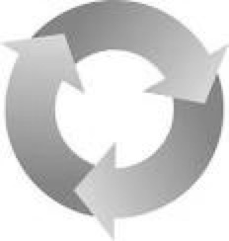
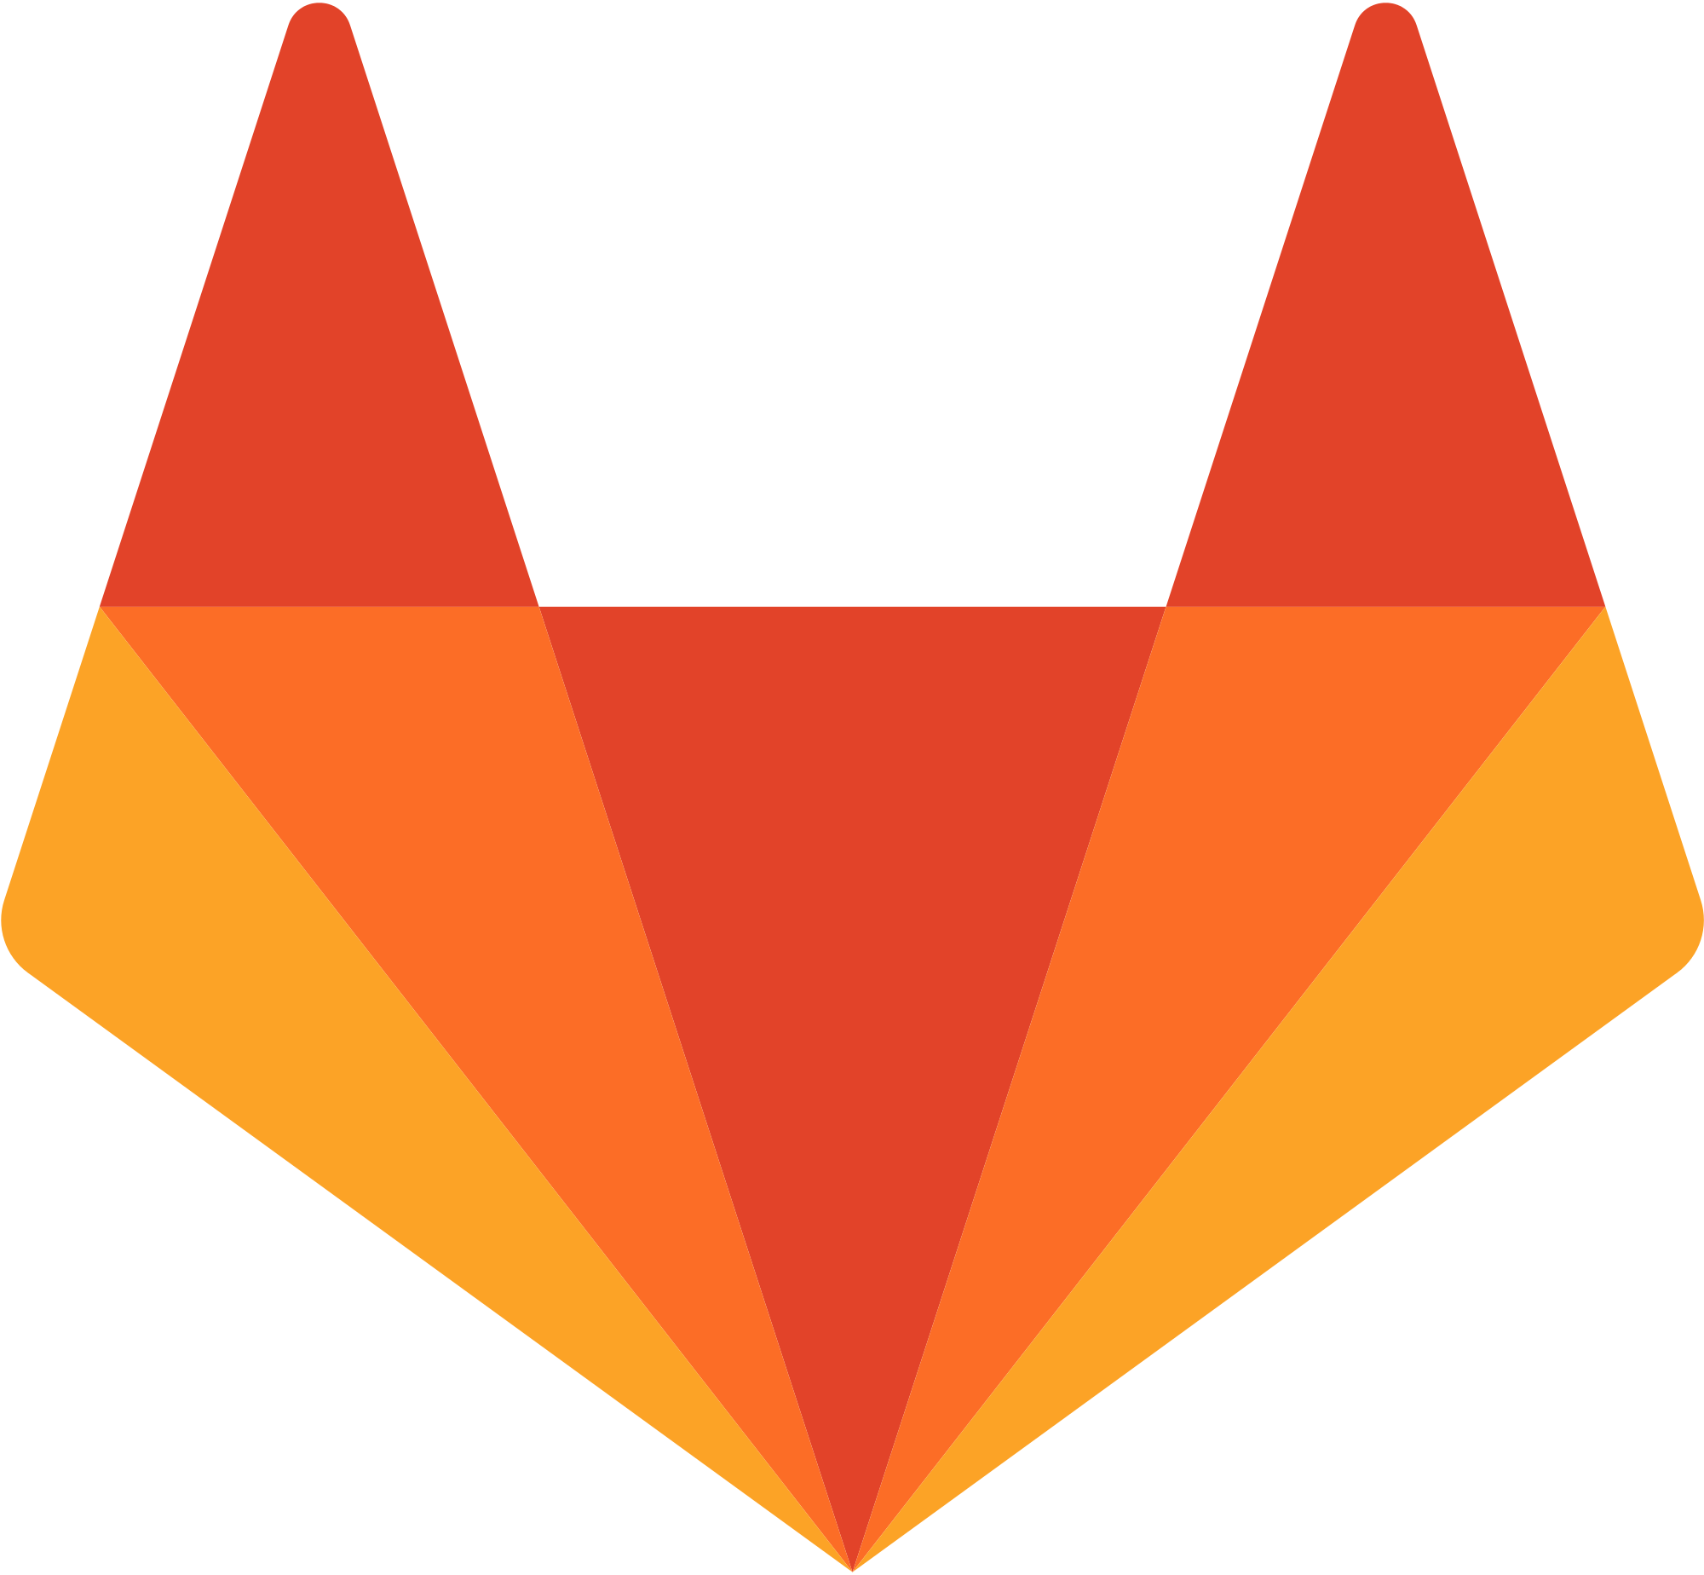
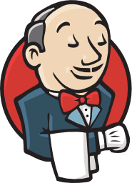

Comprehensive application lifecycle management
Commit Code Change
Automate Build & Test
(Unit Test, Static Code Analysis)
Store Binaries & Build Artifacts
Deploy, UAT, Stage App
Zero Downtime Upgrade to Production
Exploratory Questions:
What tools are your teams using today?
Build Pipeline Operations
Tool Chain
Gitlab
Jenkins
Artifactory
Pivotal Cloud Foundry
Notes:
Continuous delivery is key to iterative development process and CI/CD tools provide the framework for delivery process with transparency between Dev and Ops.
First platform built assuming CD as the prime directive. The platform integrates tools and automates processes for full app lifecycle from testing to builds and deployment
It provides a
consistent API to automate deployments,
standard tooling for all apps with
Commits from many teams rolling into production hosted env as fast as possible with safety
GitLab, Jenkins and Artifactory can also be installed on and managed by Pivotal Cloud Foundry, which makes it even quicker and easier to get these platforms up and running.
-------------------Notes on the partner and SCS products for in case of further discussion-------------------
Gitab - Source control product using GIT that includes git repository management, code reviews, issue tracking, wikis , etc. We provide a managed solution, including automated deployment, configuration, scaling & upgrade (via Ops Manager) with persisted data and configuration. Not required to be an expert in Git.
Jenkins - #1 CI tool, 8 years old. Includes the core open source Jenkins technology with advanced enterprise features developed by CloudBees. CB provides professional technical support for Jenkins and 1000+ open source community Jenkins plugins. One click install and scale w/ PCF Ops manager, integrated authentication with PCF UAA to provide single sign-on and support for role-based authentication and authorization
JFrog artifactory - Automate all aspects of artifact management using REST API. Powerful enterprise features and fine grained permissions. Advanced security and reliability features control access to artifacts, where they’re deployed and supports large load bursts with extremely high concurrency+data integrity. Can serve as internal & private docker registry access. Push button deployment , automated upgrades via PCF Ops Manager, with persisted data and configuration. Not required to be an expert in JFrog Artifactory.

Slide 23
Accelerating the velocity of each iteration
Spring Cloud Config
Dev
UAT
Staging
Production
- Dev, Test, Staging and Production on the same platform
- Bit for bit consistent environments
- Logical groupings of user access controls
Notes:
Development, Test, QA and Production are all on the same platform with bit for bit consistent environments that are just logical groupings of access control for the various roles.
Through env variables and through spring cloud config, environment specific configurations and external dependencies can be injected for each application instance to consistently and seamlessly move through each stage. This also ensures that all the apps are promoted with the same process. This is automatically enforced throughout the lifecycle into prod consistently (without having to write recipes and scripts). This really reduces breaks/bugs due to configuration drift. No more “but it works on my machine”.
-------------------Notes on the partner and SCS products for in case of further discussion-------------------
Spring Cloud Config - provides server and client-side support for externalized configuration in a distributed system. With the Config Server you have a central place to manage external properties for applications across all environments. The concepts on both client and server map identically to the SpringEnvironment and PropertySource abstractions, so they fit very well with Spring applications, but can be used with any application running in any language. As an application moves through the deployment pipeline from dev to test and into production you can manage the configuration between those environments and be certain that applications have everything they need to run when they migrate.

Slide 24
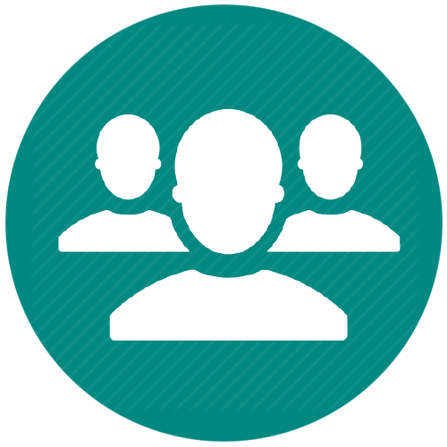
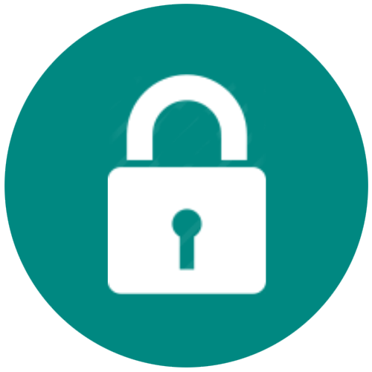

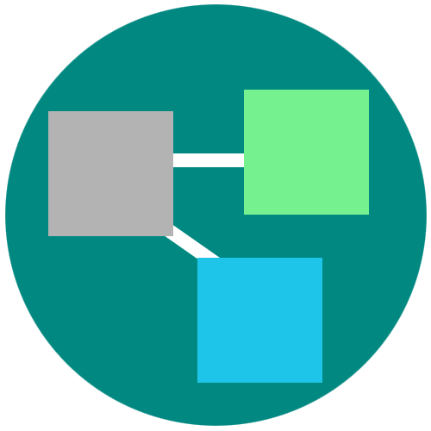



Everything to Deploy and Manage the App
1. Roles and Policy
5. Security and Isolation
6. Blue-Green deployment
2. Metrics
3. Log Aggregation
7. Scaling
4. Health management
Notes:
The previous generations of tools leave a lot of burden on operators. To minimize the number of handoffs and human effort Everything to manage the app is built in to the platform - all the pesky details of getting the app into prod, securing, patching and keeping it available.
PCF provides an abstraction layer that allow you to scale out with application containers as the unit (not the VMs). So…You will no longer need to know which VM or where your app container is running because PCF surfaces visibility at the app layer and not through infrastructure constructs like VMs. The instance of your app is the primitive that PCF uses.
Roles and Identity: Policy enforcement and role based access to platform resources are all integrated and can be set. Using our SSO service, operator overhead of enabling security for apps is drastically reduced because it’s a 1 time setup instead of an app by app effort.
Metrics, log aggregation and health management needed for the resiliency
Instant horizontal scaling; autoscale
Dynamic load balancing and routing: support for instant horizontal scaling
Fast, no downtime updates of your app w/ blue-green deployments (scroll to see optional notes section below)
Security: Security is not a once-and-done endeavor. Treatment of security is broad and ubiquitous to the entire platform. With Pivotal Cloud Foundry, every VM in your datacenter can be repaved automatically from a known good state every few hours. Vulnerable Operating Systems and application stacks can be repaired consistently within just hours of the patch becoming available. And this can be done without application downtime. We could spend a whole session on just this one topic.
<optional: If someone needs an explanation of blue green>
Blue-green deployment is a release technique that reduces downtime and risk by running two identical production environments called Blue and Green.
At any time, only one of the environments is live, with the live environment serving all production traffic (e.g blue). And the updates are applied to the the one that is not live (green).
With a single command, your incoming test traffic to “green” and if that works, eventually your live traffic from blue will be switched to green without the end user experiencing downtime due to the application update.
Once 100% traffic is on green, you can take away blue or keep it around for a bit in case you need to rollback.

Slide 25
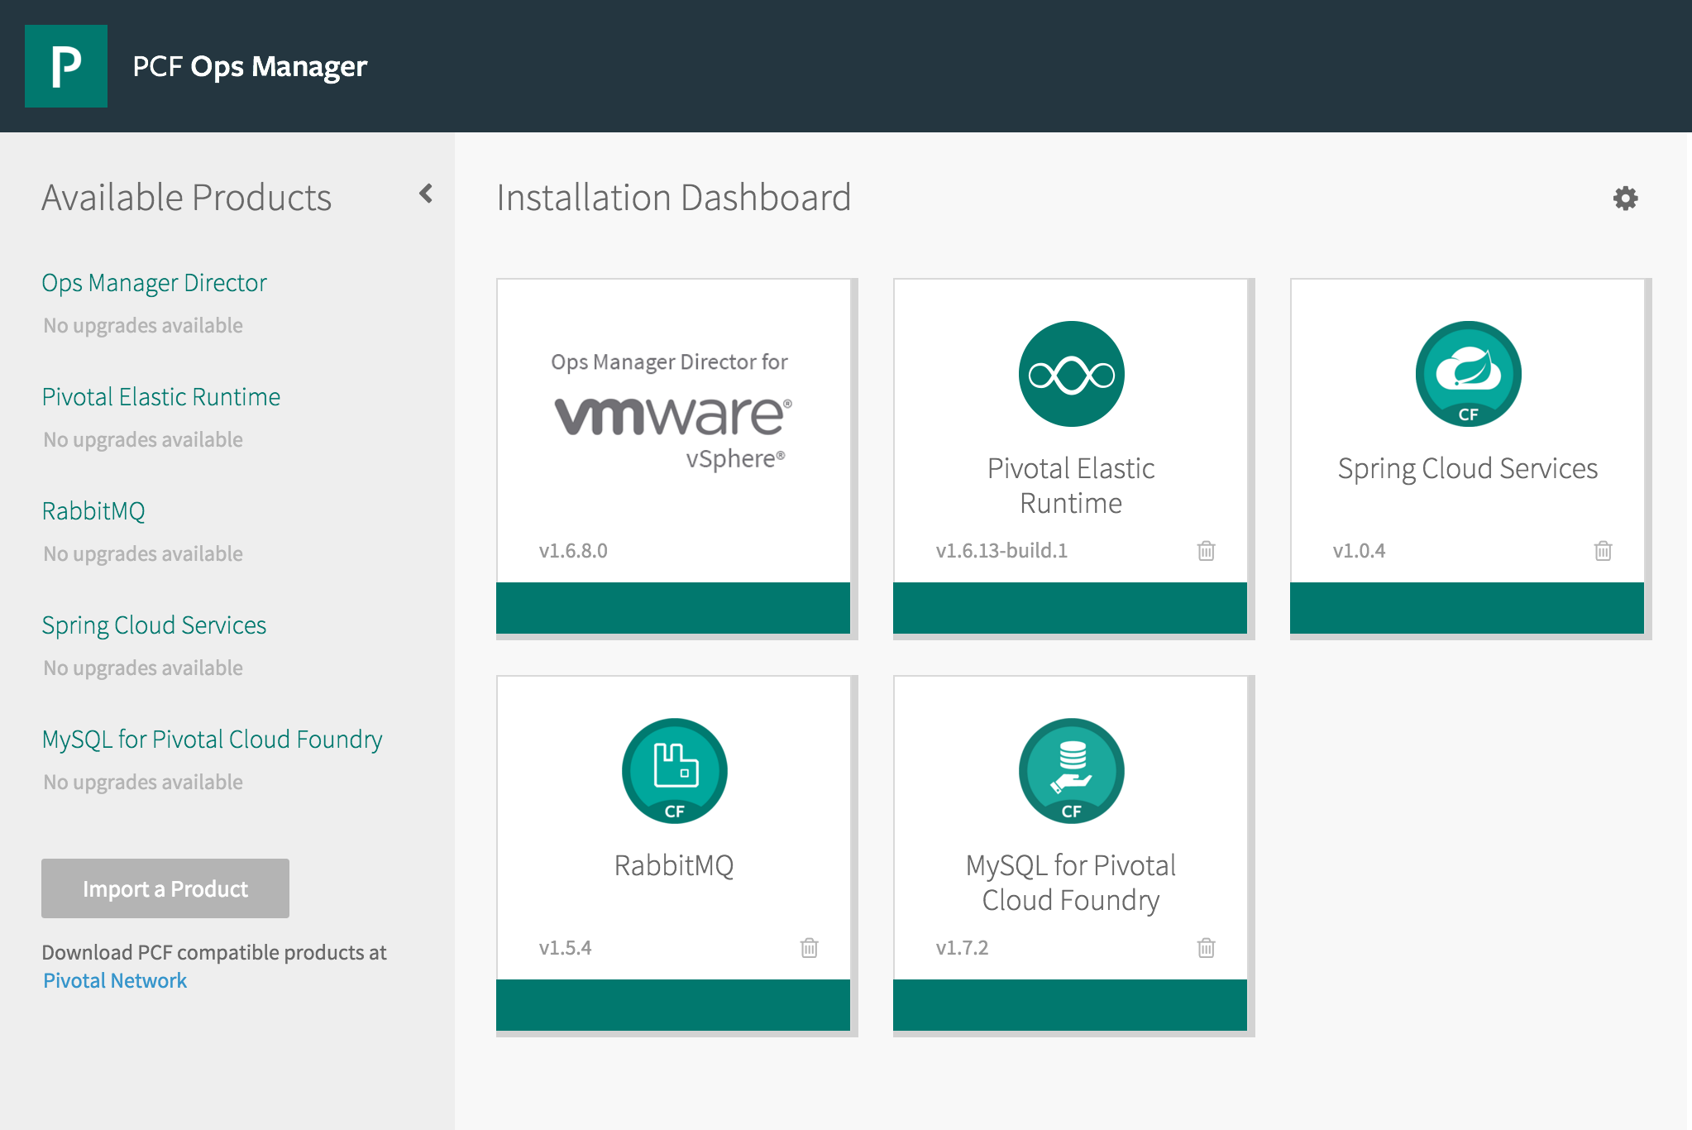
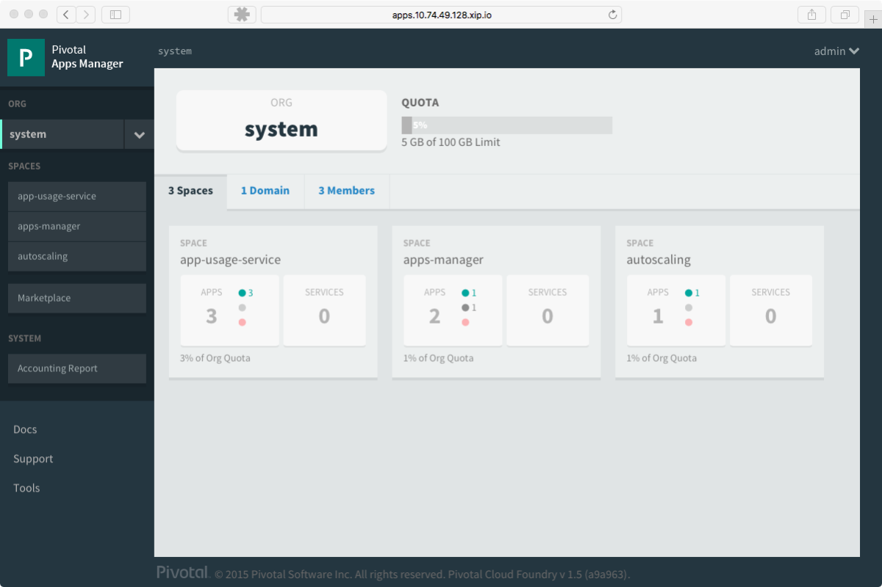
Comprehensive Visibility & Administration
Operations Manager
Applications Manager
Notes:
Consolidated management for Apps and Platform services through Apps Manager and Ops Manager dashboard is available.
Operations Manager is a web application that you use to deploy and manage a Pivotal Cloud Foundry environment on your cloud provider of choice. Its also how PCF products including the Elastic runtime and the services are installed, patched and upgraded as tiles in ops manager GUI. Its one of the ways in which you can monitor VM status and health of your overall PCF installation – like making modifications and scaling of resources that have been allocated to the different platform components. And many of these changes can be done while your apps are in flight.
Apps Manager is the GUI for managing the PCF Elastic Runtime Service and how the operators set the platform up for consumption by the development teams. Elastic runtime can be logically divided by Organizations and further into spaces with fixed quotas. Operators can also use these constructs to assign access to users without going at it on an app by app basis. Apps manager can be used to monitor applications logs, services and routes, set up access to Service Marketplace, increase or decrease the number of instances of an application, how much memory is allocated to it, the status of the application.
Between these two interfaces, operators have comprehensive visibility and administrative capability across the breath of applications, across organizations and across products and runtimes.

Slide 26
DEVELOPMENT
OPERATIONS
Multiple
Languages
App Deployment
& Management
CI/CD Tools,
ID, Security
Microservices
Support
Health, Metrics,
Patching
Availability
Services
Marketplace
Native
User Provided
Partner
Visibility &
Administration
Apps & Platform
Dashboards
Operating
System
Container Orchestration
Cloud API
Notes:
When you have a platform, you need automation underneath it.
And finally, automation’s goal is to ship comprehensive cloud services not ad-hoc automation
We talk about PCF providing an abstraction layer over VMs providing lifecycle management of large scale distributed services. It was designed with the assumption that complex systems will develop inconsistencies over time. So platform was purpose-built for what you might call “day 2 operations”. The previous generations of configuration tools leave a lot of ad hoc orchestration burden on operators to build and run a service. The difference with BOSH is that it isn’t told what to do, but its told the desired state of what it should be, and then it does the right things to make that be true. The constant checking, detection and remediation make sure that state always returns to consistency.
This resiliency is what makes PCF an excellent infrastructure abstraction layer. It mediates with the infrastructure, draws from pools of resources in order to deploy distributed services like the Elastic runtime, data services, messaging layer, CI system & others. Now operators can provision services to developers instead of machines

Slide 27

Each Layer Upgradable with No Downtime
Application
C o n t a i n e r
Blue-Green deploy
App Runtime*
Exploratory Questions:
How do they patch and upgrade today?
Do they do blue green deployments?
Are there any penalties to downtime or SLAs they are trying to meet?
File system mapping
Canary style deploy
Linux host & kernel
* e.g. Embedded webserver, app configurations, JRE, agents for services packaged as buildpacks
Notes:
The dotted line you see is the marketecture for a container. With PCF, the platform operator has push button control of the full s/w stack.
The app itself can be updated using BG deploys (Explained below)
The App Runtimes can be updated the same way. We talked about buildpacks a little earlier in relation to how they automatically determine what runtime resources are called on by the platform to deploy the app.
The buildpacks that we provide with the platform are constantly updated by Pivotal with the latest security fixes
Applying a patch or upgrading a buildpack is done by the operator with a single command.
The changes are applied to the app instance at the next cf push.
The user traffic can then seamlessly transition to the new app instance using blue-green method as usual.
And finally, operating system patches and upgrades are applied via what we call rolling canary deploys that are done “in flight” across batches of VMs until the update has permeated the whole system.
{{Pivotal platform architects can extend the script and spend more time and detail on this image asking how their org reacts to CVEs like shell shock. They can go over in detail how we can update each layer w/o using this script}}
<optional: If someone needs an explanation of blue green>
Blue-green deployment is a release technique that reduces downtime and risk by running two identical production environments called Blue and Green.
At any time, only one of the environments is live, with the live environment serving all production traffic (e.g blue). And the updates are applied to the the one that is not live (green).
With a single command, your incoming test traffic to “green” and if that works, eventually your live traffic from blue will be switched to green without the end user experiencing downtime due to the application update.
Once 100% traffic is on green, you can take away blue or keep it around for a bit in case you need to rollback.
<optional: If someone needs an explanation of canary>
When performing updates, PCF does things in batches. It allows you to specify a small number of VMs in the first batch to change.
The first batch is called the canary. PCF redistributes the workloads in to others and runs the update.
If the canary batch fail to upgrade then the deployment/change is halted. Your remaining VMs are unaffected and workloads still running. Your canary VMs are left as they are - probably broken in some way - ready for you to diagnose and fix.
If the canaray passes, the updates rolls through. Each time a subset of VMs is taken and updated the same way until all are done.
The name comes from history. Miners carried caged canaries (birds) down into the mine tunnels with them. If dangerous gases such as carbon monoxide collected in the mine, the gases would kill the canary (which is anatomically very sensitive to poisons) before killing the miners, thus providing a warning to exit the tunnels immediately.
http://stackoverflow.com/questions/16047306/how-is-docker-different-from-a-normal-virtual-machine

Slide 28

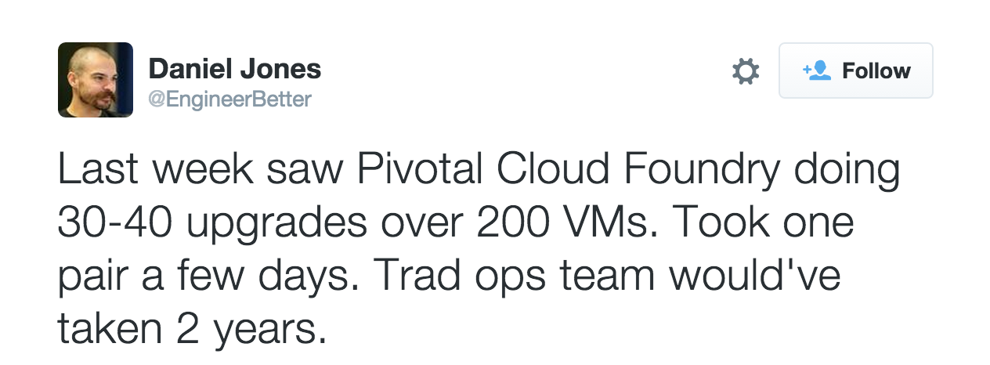

Patch With Rolling Deploys
Notes:
BOSH will handle doing Rolling Deployment of various components of the platform. This comes in pretty handy because there have been so many CVE’s lately. When the heartbleed virus hit, our customers took our patch and using canary deploys the fix ran itself across all the VMs under PCF in the data center. All they used was our GUI and 2 easy commands. And one of their engineers actually tweeted their experience where it took 2 people a few days to apply the fix, whereas if they had used traditional tools, it could taken up to 2 years to get it all.
And if devs were rolling their own Docker, without this kind of functionality, this could very quickly turn into a operational nightmare. (See below)
Automate your platform piplelines – Update your platform using the same toolchains you use to deploy your apps, more importantly, run acceptance testing every hour, if you have compliance requirements –test them, use Chaos Lemur to do break testing of BOSH components.

Slide 29
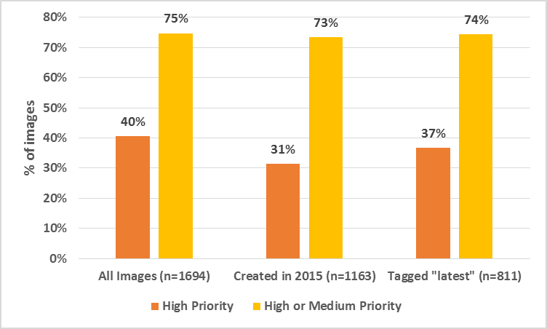
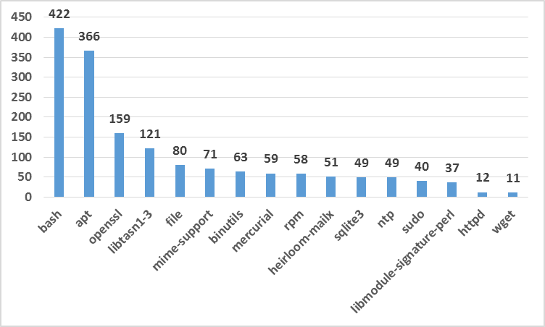

Vulnerabilities in Docker images
Notes:
If you are using Docker, you are going to have to deal with handling vulnerabilities.
Fun Trivia: Over 30% of all official images on the Docker hub contain high priority security vulnerabilities. This stat increases to 70% when you consider the medium priority secure vulnerabilities.
PCF provides choice between deploying pre-built images or creating the container “just in time” using buildpacks. The buildpacks approach reduces customer risk by providing a controlled approach to the contents of the container and minimizing the effort required to patch the OS and language level CVEs.

Slide 30



Slide 31

Improve Enterprise Security Culture
Makes it easier to do the right things
Prevents vulnerabilities due to
Leaked/misused credentials
Misconfigured/Unpatched software
Slow & rigid processes
Notes:
<OPTIONAL> We could spend a whole session on just this one topic.
But to cover a few highlights:
Protection from security threats is done by
Architecting the platform to minimize network surface area with a limited number of contact points with the public internet
isolating customer applications and data in containers
encrypting connections-IPSec
Applying admin configurable security controls like rules to prevent system access from external networks and within internal components
Simplified vulnerability management, patch management which we’ll see more of later. – App Sec groups
Prevents possible denial of service attacks through resource starvation.
The platform makes it radically easier to do the right things that prevent vulnerabilities that are caused by leaked/misused credentials, misconfigured or Unpatched software.
It prevents delays due to well intentioned, but rigid processes – which ironically allow the threat to persist in the environment for a long time even after it is detected.
In general, the Platform focus on automation & abstraction simplifies governance throughout app lifecycle making it a repeatable process that is trivial to implement for your app.

Slide 32

Compliance and Security
Speed is the new security

Slide 33


Automation Pays Dividends
Consistency via pipelines
Continuous Deployment via triggers
Auditing
Security/Immutability (No humans)
Upgradability
Recovery
Notes:
You get speed by automation

Slide 34
Platform Trust
Repave, Repair, Rotate - more secure architecture
Zero downtime deployments and upgrades
Explicit, known dependencies
Homogeneity in the environment, no drift
Combined CVE / vulnerability management
Federated login with enterprise directories
Control access to services and other resources
Enforce policies (server, runtime, libraries, etc.)
IPSec on every network segment
Custom monitoring agents
(Soon) runC integration for AppArmor and user namespaces

Slide 35
Additional Host Security
Automated Pipelines to track and update Stemcells and buildpacks
Stemcell hardening
Vulnerability Scan - Nessus scan
Integrity and Intrusion management – TripWire
Anti-virus
Constant automated code quality testing
Automated Pen testing scans
Dashboard and alerts (e.g. https://compliance-viewer.18f.gov/)

Slide 36
Let’s Replatform - App Modernization
Believer in opinionated platforms, enforcing cloud-native design
Shipping microservices with full CI/CD, automated lifecycle management
Struggling with modernizing applications, reskilling
Cloud Native
Believer in reproducible builds, operational visibility, open-source
Shipping a container runtime, microservices, automated provisioning
Struggling with adhoc operations, manual CI/CD, unintegrated tools, curating OSS
Containers
Believer in automation, opinionated software, microservices, 12 Factor
Shipping API-first applications,
Struggling with adhoc operations, lack of tooling and monitoring, security
DevOps
Believer in agile, speed to market, software as a differentiator
Shipping greenfield projects in public cloud because on-premise is too slow
Struggling with CI/CD, provisioning environments, lack of operational visibility
Agile
Believer in IT as a cost center, large projects, customizing off-the-shelf software
Shipping completed software projects
Struggling with failed projects, long lead times, business advantages of software
Traditional
Notes:
PCF platform is not just for Cloud Native Apps.
When you look at different levels of cloud maturity, you can use PCF to move from a traditional IT organization to a Cloud native org.
The Enterprise IT Strategy Journey

Slide 37

Modernization Strategies
Evaluate your application portfolio, which apps are under active development,
and the cost/benefit of refactoring an app to a 12 Factor design.
Rehost 12 Factor apps
Refactor/rebuild app to 12 Factor and containerize
Refactor/rebuild app to BOSH virtual machine
Large scale rearchitecture for service and data decomposition
Modernize with microservice components and integrate legacy apps via APIs. Professional service options for knowledge transfer, app evaluation and delivery.
Notes:
You have a range of options for modernizing application that depend on how cloud-ready each application is. Existing 12 Factor applications, which are built for to be horizontally scalable and resilient according to the design methodology outlined at 12 Factor dot Net, can be immediately rehosted on the platform. Other apps that are close, but still require say, permanent disk access, can be refactored or rebuilt to meet the platform contract.
Option C is a more advanced middle-ground option to refactor applications so they can run in virtual machines on Cloud Foundry infrastructure, using our open-source BOSH project. BOSH is a low-level, opinionated platform for application clustering. We find that once customers are successful on the platform, they may want to start investing in BOSH as a middle ground, especially for older applications that they don’t want to completely redesign. Liberty Mututal is a customer of ours that is a big proponent of BOSH. I can explain in more detail if useful.
Finally, you can consider a major rearchitecture of a system. Option D requires decomposing services by business function, decoupling data and application logic, and migrating it to the platform.
The most common paths are options B and D. We have expertise with people like Matt Stine’s. I can forward you a copy of our free O’Reilly book, ‘Migrating to Cloud Native Application Architectures’ that can help. We also have professional services to position projects for you.
What you won’t see here is ‘just containerize the app’. That’s because we’re in the large distirbuted systems, which means building reliable systems from unreliable components. Our elastic runtime is build to offer production-level automation and health management that you can’t get by just wrapping your app in a container.

Slide 38










Rehost, Refactor & Rearchitect Strategies
Traditional App
Environment
Platform Runtime
BOSH VMs
Load Balancer
Web Server
API
Gateway
Microservice
App
12 Factor
App
App
Server
App Server
Backing Services
Off Platform
Database
Dynamic
Router
Service
Discovery
Database
ERP
ERP
Notes:
How do the app modernizations options look on Cloud Foundry? If you look at a somewhat simple traditional app architecture on the left, when you bring this over to a platform environment you have a range of options for modernising it for a platform environment. You can rehost 12 Factor apps immediately, or refactor somewhat-ready apps to meet 12 Factor design principles.
The elastic runtime can run any 12 Factor app, connecting to databases and routing as attachable backing services. All applications in the elastic runtime are run in containers.
You can completely rebuild applications with a microservices approach.
Finally, sitting in-between full cloud native and leaving your apps as-is, sits the option to refactor applications to run on opinionated, BOSH-managed virtual machines.
Check out our case study on refactoring a monolith into a cloud-native app at https://blog.pivotal.io/pivotal-cloud-foundry/case-studies/case-study-refactoring-a-monolith-into-a-cloud-native-app-part-1

Slide 39

Evaluate Your Microservices Competency
Rapid Provisioning Fast Deployments DevOps Culture Basic Monitoring
- Martin Fowler
Notes:
As you embark on the micorservices journey, evaluate the core competencies that you are building. Keep in mind microservices is not about technology but the ability to bring functionality quickly to the customers.
One of the major considerations on the application modernization strategy, is how ready your organization is to build and manage microservices-based applications. Martin Fowler, software development author and speaker, outlined a range of DevOps culture and technical capabilities that teams need to succeed. Your organization must be this tall to use microservices.

Slide 40


Slide 41
Container Networking
CNI
All app containers are connected to a single, system-wide routed (L3) IP network, henceforth known as The Container Network
App containers have a single network interface and a single IP address, numbered out of a contiguous address block
All traffic over The Container Network is subject to policy
Network policies may be changed dynamically without restarting applications

Slide 42

Container Networking

Slide 43
Container Networking
Network Endpoints
A Network Endpoint is an IP address & virtual network interface attached to a Network.
Endpoints Groups
Policy is defined not in terms of Endpoints but in terms of Endpoint Groups and Target Types. An Endpoint Group is a set of one or more Network Endpoints which are indistinguishable from a policy perspective. A Network Endpoint belongs to exactly one Endpoint Group.

Slide 44

Container Networking

Slide 45
Container Networking
Create Policy
cf allow-access SOURCE-APP DESTINATION-APP --protocol PROTOCOL --port PORT
List Policy
cf list-access
cf list-access --app MY-APP
Delete Policy
cf remove-access SOURCE-APP DESTINATION-APP --protocol PROTOCOL --port PORT

Slide 46
Application Security Groups
Definition
Set of firewall rules that specify protocols, ports, and IP addresses where an application can send outbound traffic.
Scope
ASGs for staging an app
ASGs for running an app
Granularity
Across a foundation
To an Org or Space

Slide 47
Application Security Groups
Viewing
cf security-groups
Cf staging-security-groups
Cf running-security-groups
Cf security-group <NAME>
Creating
cf create-security-group SECURITY-GROUP PATH-TO-RULES-FILE
cf update-security-group SECURITY-GROUP PATH-TO-RULES-FILE

Slide 48
Application Security Groups
Binding
cf bind-staging-security-group SECURITY-GROUP
cf bind-running-security-group SECURITY-GROUP
cf bind-security-group SECURITY-GROUP ORG SPACE
cf bind-security-group SECURITY-GROUP ORG

Slide 49
Isolation Segments
Definition
A group of Cloud Foundry resources (compute, network, logging) to which applications can be targeted for deployment

Slide 50

Isolation Segments

Slide 51

Network Architecture

Slide 52
Network Security Groups
Subnets
Public – Load Balancers.
Infra - OpsManager,
ERT – GoRouter Diego, etc.
Standard Services
Dynamic Services
NSGs
OpsMgr – Only HTTP/S
ERT VMs – Only within the VPC
Load Balancers – Only HTTP/S
Services – Only within the VPC

Slide 53

PCF Capabilities

